Slide 1
PCORI Symptom-based Adjustment of Inhaled Steroid Therapy Study (The ASIST Study) for Mild Asthma
NASN Advancing Health Equity for Students with Asthma Community of Practice
March 7, 2024
Notes:
Welcome to the first NASN Advancing Health Equity for Students with Asthma Community of Practice.
This CoP is dedicated to the dissemination and implementation of PCORI Symptom-based Adjustment of Inhaled Steroid Therapy Study (The ASIST Study) for Mild Asthma.
PCORI – Patient Centered Outcomes Research Institute
ASIST – Asthma Symptom-based-adjustment of Inhaled Steroid Therapy
Since this is our first meeting we are going to cover some basics today. I am Ann Nichols, Nurse Consultant for NASN in this PCORI work, and on the ESC Data Initiative. Please put your name and your state in the chat at this time if you have not already done so. Today I will talk more than normal since a CoP is intended to be a collaborative, interactive meeting. But please feel free to post comments or questions – Dr. Deborah D’Souza Vazirani will be monitoring our chat today. I encourage your questions/comments today!

Slide 2
What are Communities of Practice?
“Groups of people who share a concern or a passion for something they do and learn how to do it better as they interact regularly.”
Wenger-Trayner, E., & Wenger-Trayner, B. (n.d.). Introduction to Communities of Practice. Retrieved from http://wenger-trayner.co m/introduction-to-communities-of-practice/
Notes:
Community of Practice is not a term that is know to everyone. If you are a member of NASN, you may participate in other communities – like ESCs if you are a Data Coordinator. There are sometimes communities organized around nursing care in particular areas of practice, or directed towards a specific chronic condition diagnosis. This is the description of a community of practice as we envision it. If you want to generally know more there is a link on this slide to the source of this quote. CoPs are a great way to both distribute information, and to learn from practicing school nurses. After today’s meeting we will post these few slides in the Community library.

Slide 3
How does a Community of Practice Work?
Regularly scheduled meetings
Common on-line presence for resources and discussion between meetings
Facilitator role for planning, managing meetings, and oversight of on-line discussions
Participants with a common interest or need
Use the resources; bring your questions and suggestions
Integrate new knowledge into practice
Share experiences and local resources
Participate in on-line discussions
Actively participate in meetings when opportunity exists
Recognize your contribution to nursing knowledge in this area
NASN Advancing Health Equity for Students with Asthma
Notes:
It is always important to know benefits and expectations for participation in something like a CoP. So let’s look for a moment at how a Community of Practice will work. If you have not yet been there, the blue name on the left of this slide is the name of our CoP. This is also a live link to the home page. Rather than go there and risk conflict of live platforms I have a screen shot that we will look at in a minute. But this is largely a good overview.
We will have regularly scheduled meetings and will share those dates with CoP messaging reminders. We hope that you attend as many as you can, but also understand that unexpected things come up regularly for school nurses.
Our common on-line presence between meetings is the NASN CoP site in blue. I will talk about different actions when we go to the next slide.
Today I am the facilitator, and although other people may lead future topic meetings, I will participate in that manner on-going.
You all – school nurses from Florida, Georgia, North Carolina, and Ohio are participants in the CoP. We want you to feel that this is a ‘working’ space for you where you can learn and share. So we are asking you to …
My favorite format for a CoP meeting is to pose some thoughts or questions at the start, to separate into multiple rooms for discussion of those things, and then to come back together for sharing of the outcome of those discussions. Then we provide a recording and copies of things that are pertinent for later use.

Slide 4
Notes:
This is a screen shot of the NASN CoP. There are a couple of things I’d like to point out and if you are not an NASN member there will be an extra step for you. Just under the blue banner we have the tabs for Home, Discussion, Blogs, Events, and Members. Those tabs are all accessible to you when logged in. On this home page the latest posts run on the right with the newest on top. You will need to join the CoP in order to have functionality to post or respond. If you are an NASN member you will log in and then go to this home page and a red JOIN button will be on the top right of the page. If you are not an NASN member you will create an NASN account and sign in, and then when you go to this home page you will see the same JOIN button. If you do not join the CoP you will not get the discussion posts, reminders or notice of things in the library. Your use of the site is pretty much limited.

Slide 5
It is important that you do not create a new account if you already have one. If you only need assistance logging in, contact NASN.
Start at the LOGIN form.
Select create an account.
Enter your name, email address, a password, and other information requested.
Locate and reply to the email requesting you verify your email address.
Once you have verified your email address you can access the CoP homepage and join.
Notes:
If you do not have an NASN account this is how to create one.

Slide 6
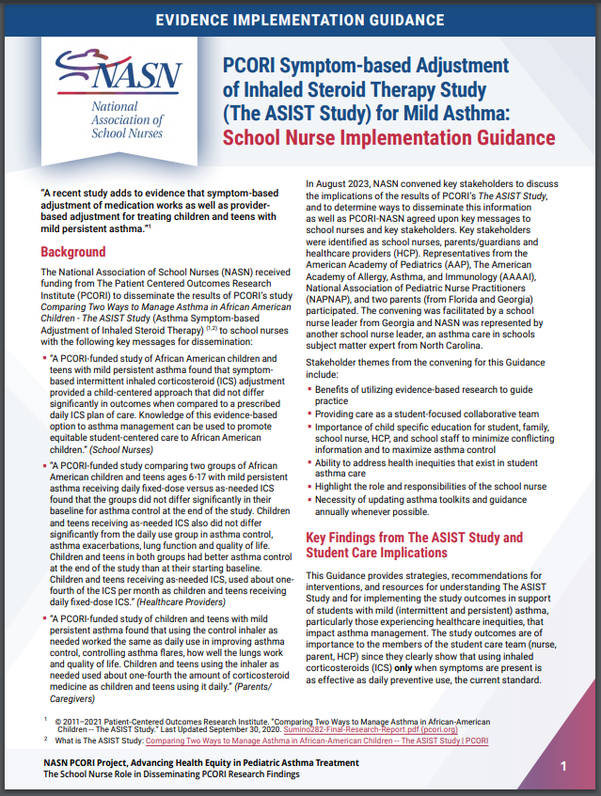
NASN Evidence Implementation Guidance
Notes:
Today we are highlighting this document that is an encapsulation of the information that we will focus on from the ASIST study. It is a four page document. A copy is housed in the CoP library, and also available at the link on this page. It is a great place to start to get a good feel for this change in asthma management that has a clear evidence base. Even if you do not start identifying students for whom a switch to symptom-based ICS use might be warranted, you will probably start getting students with these orders.

Slide 7
Summary of the PCORI ASIST Study
NEW Symptom Based Adjustment
(SBA)
Traditional Provider Based Adjustment
(PBA)
Patients used steroid inhaler (ICS) on a daily basis regardless of asthma symptoms
Met with medical provider to adjust dosage order for inhaler
Patients used steroid inhaler only when experiencing asthma symptoms
Used with albuterol
Patient directed decision to use
Rescue (albuterol) inhaler
used for
symptoms
Notes:
I am not going to go into details today about the ASIST study – just this basic info to help you see the importance if you have not already been exposed.

Slide 8
Common Challenges in Asthma Management
Staff, family and student think that every instance of being ‘winded’ is asthma.
No rescue inhaler at school.
No access to spacers.
Inconsistent or no use of daily steroid inhaler for prevention at home.
Inconsistent or no family member assistance with home management.
Presence of SN for auscultation of student and instruction on differences.
Work with family and local resources. Consider stock albuterol.
Ask provider to order a spacer with med. Include disposable spacers in office supplies.
Assess student qualification for ‘symptom-based’ ICS and engage family/provider (p.2).
As above and consider other strategies from Guidance Document (p.3).
Notes:
The inequities that exist in the lives of some students can result in challenges for those students, their families and ultimately the school nurse. I am sure that you have had those students and are aware that lack of access to care in a community, being underinsured, living in poverty, being a member of certain ethnic groups, lack of comprehension, forgetfulness, and daily life issues can all contribute to poorer outcomes for students with asthma. Part of the excitement about this evidence is the part that it can play for certain students.

Slide 9
What do I do next?
1. Join and use the Community of Practice.
2. Review the resources on symptom-based use of inhaled corticosteroids.
3. Look at your students with mild asthma who are regularly challenged in management at home and school.
4. Follow the Implementation Guidance for identified students.
5. Share your questions, observations and successes.
Your call to action

Slide 10
Questions and Comments?

