Slide 1
PCORI Symptom-based Adjustment of Inhaled Steroid Therapy Study (The ASIST Study) for Mild Asthma
NASN Advancing Health Equity for Students with Asthma Community of Practice
April 25, 2024
Notes:
Welcome to the first NASN Advancing Health Equity for Students with Asthma Community of Practice.
This CoP is dedicated to the dissemination and implementation of PCORI Symptom-based Adjustment of Inhaled Steroid Therapy Study (The ASIST Study) for Mild Asthma.
I am Ann Nichols, Nurse Consultant for NASN in this PCORI work, and on the ESC Data Initiative. Please put your name and your state in the chat at this time if you have not already done so. Please feel free to post comments or questions – we encourage use of the chat feature and Deborah will monitor for anything that is needed.

Slide 2
Agenda
Welcome, Intros, Today’s Focus
Hear from Fulton County Schools, Georgia
Paulette Abbey, MSN, RN, Riverwood Cluster School Nurse
Claudette Myers, RN, BS, CCM, District Health Services,
Asthma Care Coordinator
Reminders and next meeting

Slide 3
Asthma friendly school
Fulton County Schools
Paulette Abbey, MSN, RN, Cluster School Nurse
Claudette Myers, RN, BS, CCM, FCS Asthma Care Coordinator
Lynne P. Meadows, MSN, RN, Director, District Health Services

Slide 4
About us
Fourth largest school system in Georgia
Over 89,000 students
Diverse demographics-41% African American, 26% White, 16% Hispanic, 13% Asian, 4% Biracial
104 schools (59 elementary, 19 middle, 18 high, 7 charter, 1 virtual school)
School Health Team
25 Registered Nurses (19 Cluster School Nurses and 6 Special Education Nurses) –providing indirect care and oversight to 5-10 schools.
Clinic Assistants (Unlicensed Assistive Personnel) manage the health needs at each school and are responsible for managing asthma care of students
Asthma Care Coordinator-contract part-time
Notes:
As a Cluster School Nurse, our role is primarily case management and indirect care with students who live with a diagnosis of asthma. We review their asthma action plans and train school clinic staff and teachers on asthma care and warning signs and often follow up with parents and the student when 911 is called from school.

Slide 5
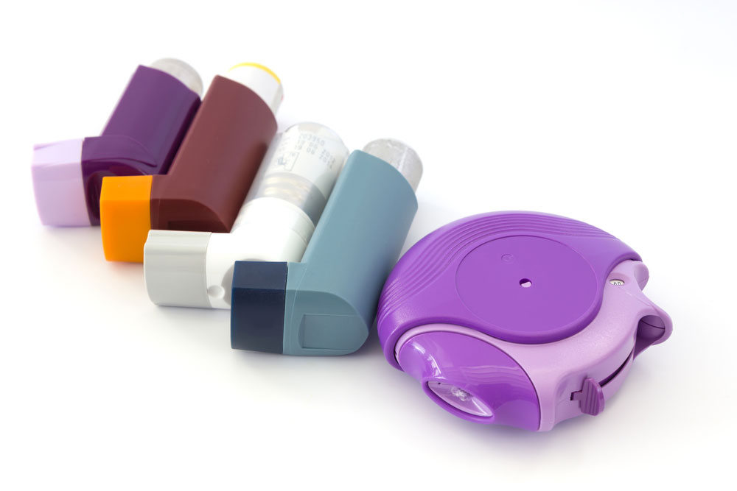
Asthma friendly school district
Fulton County Schools was recognized as an Asthma Friendly School District in 2020
Asthma Friendly School Procedures
Staff Education-classroom helpful hints tip sheets, professional development training
School Surveillance-identify students with significant asthma morbidity
Student Support-partnership with health organizations, stock albuterol/epinephrine, self administer asthma and anaphylaxis medications
Notes:
A few of the procedures implemented as an asthma friendly school includes staff education. Teachers and school staff are offered asthma education and provided classroom tip sheet which includes an overview of asthma, s/s, how to respond to an emergency and instructions on administering an inhaler for specific students in their classrooms. School clinic staff receive asthma training throughout the school year. Each FCS employee has been provided signs of asthma attack card to place with their id badge from DPH and we provided air quality flags for each school.
School surveillance-is based on parent health information and asthma action plans. School nurses validate information and share health information with teachers and administrators. School health alerts are updated routinely to ensure students with asthma are identified.
Student support-we have a partnership with CHOA Mobile Van and our three school based health centers who provide asthma education, asthma actions plans and medications. Each school stocks albuterol and injectable epinephrine. Students are allowed to carry and self manage their asthma and allergy symptoms.

Slide 6
Funding opportunities
Fulton County Schools was awarded grants for 21/22 through 23/24 school years.
Goal was to implement and continue school-based asthma education and care coordination for underserved asthma students.
Hire and maintain Asthma Care Coordinator position
Notes:
Fulton County Schools was awarded a grant to implement school based asthma education and care coordination for underserved asthma students. The grants provided the opportunity to hire an Asthma Care Coordinator to implement staff training and student asthma self management classes. Grant objectives included improving student’s seat time (grades), increase access to inhalers/asthma plans, increase in physical activity, and increase staff knowledge of asthma and management
Each year schools were identified based on school nurse referrals, socioeconomic status, and high-risk zip codes of asthma related emergency room visits.

Slide 7
School based asthma initiative implementation
Principal approval to agree for the sessions to be taught and identify a school-based coordinator to assist with scheduling
Asthma Care Coordinator(ACC) and Cluster School Nurse team conduct student self-manage asthma education (AS-ME) sessions
Open Airways for Schools (OAS)-Elementary and Kickin Asthma-Middle School
Parental consent is required for student participation-based on school/organization requirement, consent option may be active or passive permission
Asthma Team (ACC, School Nurses)provides asthma education to teachers and school staff
Partnership with healthcare providers and School Based Health Centers to complete asthma action plans and student’s access to asthma medications
Notes:
Principals had the option to have their asthma scholars participate. Informational email was sent to the principals to approve the program. School based point of contact was identified by the principal to assist with coordinating dates and times of the sessions. Asthma letters were sent home with students to obtain parental consent. Healthcare provider came onsite at schools to provide asthma screenings, complete asthma action plans and prescribe medications. The asthma care coordinator and I were able to become asthma facilitators completing the Open Airway for Schools (OAS) and Kickin Asthma trainings by American Lung Association

Slide 8
Positive outcomes
Over the past 3 years, we have provided ASME classes to a total of 23 schools. There were total of 304 participants. Students thoroughly enjoyed the sessions and were very engaged. We believe that they were able to take away valuable information regarding their asthma, triggers and ways to address symptoms
Improved number of students with access to their rescue inhaler and asthma action plans at school
Improved student’s knowledge of their asthma and self management
Staff showed improvement of asthma knowledge
Research showed success in school-based programs requires the collaboration of community stakeholders
Notes:
Grant funding required data collection. During the first year of implementation, based on data collection from the Healthcare Foundation Grant objectives 56% of students who participated in our asthma sessions increased their overall academic grade percentage between the fall and spring semesters. 46% of study students saw a 20% decrease in school absenteeism. 17% of students who visited the clinic for inhaler use decreased their number of visits by 20 percent over the 2021/22 academic year. With staff asthma education, 66% of staff increased their score between the pre and posttest after participating in asthma training (range of 10-to-40-point increase).

Slide 9
challenges
Securing schools to participate in asthma sessions
Initially, Covid limited visitors into schools and delayed implementation of the program
Staffing- additional school nurses or trained asthma facilitators needed
Identifying barriers to participation-2nd year changed consent to passive resulting in increased participants
Communication-lack of response from school principals and/or coordinators to schedule sessions, lack of responses from parents to complete surveys
Lack of funding to continue future sessions and asthma program
Notes:
Additional schools beyond the 23 were offered asthma classes but did not participate due to lack of response from school administration and/or non parental consent. The first year we rolled out returned consent requirement resulting in low numbers. The change of passive consent with parent having to opt out, improved participant rates.
Staffing -additional school nurses or partnership with asthma facilitators from the community is needed to provide student asthma education sessions throughout the district. Our current caseload prohibits expansion of sessions
Communication was the biggest challenge that we encountered. This includes between parents, teachers, and staff. We send communication by phone calls, email, paper documents from the school However, utilizing interpreter services and bilingual school staff for parent with limited English proficiency has been an accomplishment with successful participance rates.

Slide 10
Asthma program implementation tips
Collaborate with stakeholders-school based health centers, school administration
Identify an Asthma Champion within the school
Develop and maintain an Asthma Care Coordinator position to support the program
Partner with local communities to secure health worker or asthma facilitator to conduct classes
Coordinate asthma education sessions based on school nurse referrals, previous school participations and principals' responses agreeing to participate
Initiate classes during the beginning of the school year (i.e. October)
Develop an introductory letter to principals explaining asthma education sessions linking academics and positive asthma outcomes
When sending parental consents home with student make sure to document content of envelope.
Identifying school contact to coordinate services (Clinic Asst, AP, health ed. teacher)
Notes:
This school year we have been able to implement the asthma sessions sooner in the year with hopes to add additional schools. Identifying a school designee has improved coordination of scheduling dates. Communication to principals should not be too lengthy and also address reducing absences and improving academics. We prepare each sessions modules in advance including all lesson plans for each student and a separate folder to take back and forth with parent letters from each sessions. Incentives are given to students for participating-snacks, candy, gift bag at the last session including education materials for both student and parent.

Slide 11
The assist study & the school nurse role
The ASIST study results, and School Nurse Implementation guidance provides resources to support students living with asthma.
Explaining the study outcomes and the benefits in the changes of inhaled corticosteroid use only when symptoms are present vs daily use may increase medication compliance.
Clinic Assistants(unlicensed assistive personnel) and possibly nurses may not be familiar with common indicators, NIH and Global Initiative for Asthma (GINA) guidelines which identifies the asthma severity levels.
Increasing knowledge to the school health team to be aware of the indicators and asthma severity level provides additional guidance on how to monitor the student’s symptoms with physical activity, clinic visits and inhaler use so that communication can improve between the parent and healthcare provider.
Notes:
As a school nurse, there are so many challenges with children managing their asthma. Often being lack of access to care, financial needs, and lack of the student and parent/guardian understanding asthma actions plans and their medication regimen.
I often learn from parents that there has been hesitancy with inhaler used based on being a steroid and potential side effects.

Slide 12
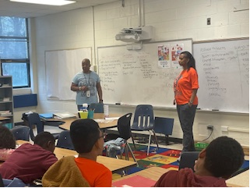
School Nurses Make a difference!

Slide 13
Thank you
Any Questions?
CONTACT INFO:
Paulette abbey, abbeyp@fultonschools.org
Claudette myers, myersc4@fultonschools.org
Lynne Meadows, meadowsl@fultonschools.org

Slide 14
What next?
1. Join and use the Community of Practice.
2. Review resources on symptom-based use of inhaled corticosteroids.
3. Consider students with mild asthma who are regularly challenged in management at home and school.
4. Follow Implementation Guidance for identified students.
5. Share questions, observations, successes.
6. Attend future CoP: May 23rd, 3:30pm, EDT

