Slide 1
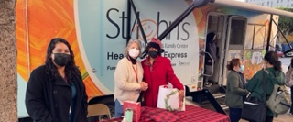
School Champions Union Rescue Mission Downtown L.A. Kids Vaccine Clinic 12/3/22
Observations
Homeless encampment stretched for miles
LVN and Lead Nurse pictured with Tracey, cross matched the LAUSD data base with state system
156 targeted kids with gaps in required vaccines
St Johns provided 1 instead of 2 mobile vans. Will return on 12/10/22
Average kid required 2-3 required shots
1

Slide 2
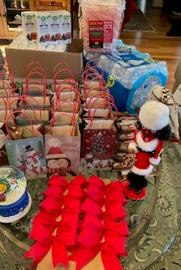
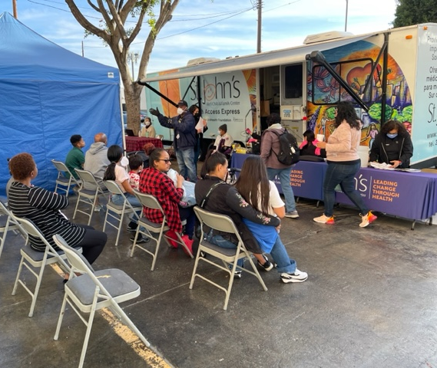
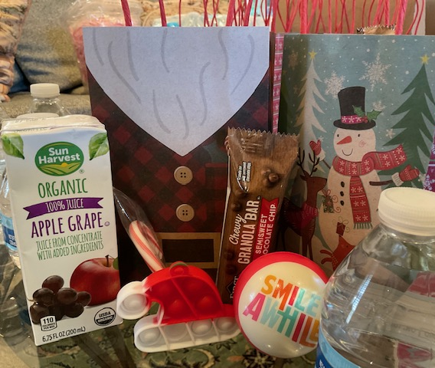
School Champions consumer feedback: ‘Kids treat bags & gift card incentives worth the wait-like early Christmas’
2

Slide 3
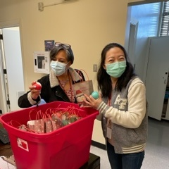
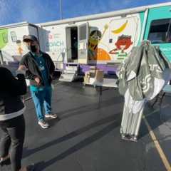
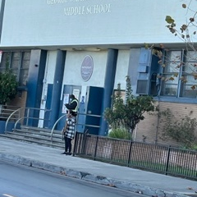
School Champions: George Washington Carver Middle School Kids Vax Clinic (South L.A.) Monday 12/05/22
LAUSD nurses were delighted with the kids inspirational
stress balls & goody bags
Cedars Coach for Kids Staff was
well organized
Carver Middle School staff cleared the sidewalks promptly by 8 am
3

